Slide 1
Title: Detect pixelated image and convert it
Prepared by:
Mausam Soni
(2203396160345)
Guided by:
Prof. Ashish Pandey

Slide 2
Problem Statement
I’m aiming to create a system that can spot and improve pixelated and blurry images, making them clearer and more detailed. This involves developing algorithms that can accurately recognize pixelation and blurriness, using techniques to upscale pixelated images and sharpen blurry ones. We'll also employ machine learning models like CNNs to enhance images effectively. We'll evaluate our progress using metrics like SSIM. Our goal is to turn degraded images into sharp, high-resolution visuals suitable for both professional and everyday use, making them more useful and appealing across different fields.

Slide 3
Unique Idea Brief (Solution)
Objective: Our goal is to create a system that can identify and enhance pixelated and blurry images, making them clearer and more detailed.
Approach:
- We'll develop algorithms to accurately spot pixelation and blurriness.
- Techniques will be employed to upscale pixelated images and sharpen blurry ones effectively.
- Leveraging advanced machine learning models like CNNs, and SRCNN we aim to enhance images with precision.
- Our progress will be measured using metrics to ensure quality improvement.
Outcome: Our aim is to transform degraded images into sharp, high-resolution visuals suitable for both professional and everyday use.
Impact: By enhancing usability and visual appeal across various fields, from digital media to medical imaging, we strive to make these images more useful and appealing to users everywhere.

Slide 4
Features Offered
1. Spotting Issues: Algorithms that can recognize pixelation and distinguish it from blurriness in images, ensuring precise targeting of enhancement efforts.
2. Improving Quality: Techniques to make pixelated images clearer without losing details, enhancing their fidelity and visual appeal.
3. Enhancing Sharpness: Algorithms that sharpen blurry images by enhancing edge clarity and definition, improving overall image crispness and detail.

Slide 5
Process flow
Step-1. Spotting Issues: Algorithms figure out if the image is pixelated or blurry.
Step-2. Understanding the Problem: Determine how much the image quality is degraded and decide what fixes to apply.
Step-3. Making Pixels Clearer: Use techniques such as SRCNN to make pixelated images sharper and clearer.
Step-4. Sharpening Blurry Areas: Apply algorithms to make fuzzy parts of the image clearer and more defined.
Step-5. Learning and Improving: Use advanced learning models (like CNNs) to keep getting better at enhancing images.
Step-6. Checking the Results: Measure how much better the image looks using metrics like SSIM to make sure the improvements are good enough.

Slide 6
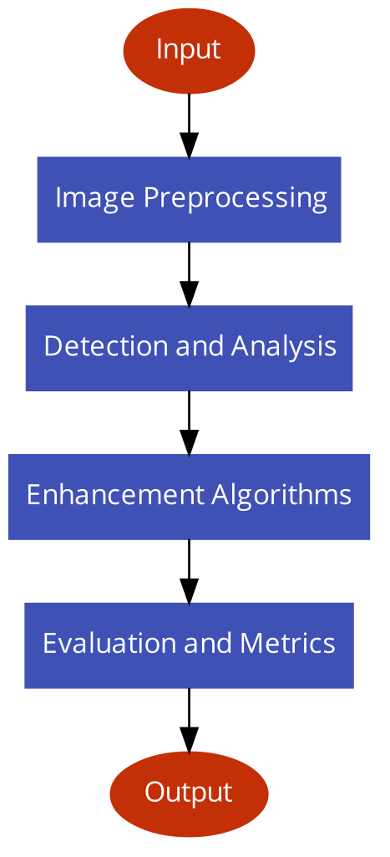
Architecture Diagram

Slide 7
Technologies used
Software Tools Used:-
Python(Programming Language)
PyCharm(Code Editor)
Algorithm Used:-
Super Resolution Convolutional Neural Network (SRCNN)
Convolutional Layer(Conv2D)
Loss Function(mean_squared_error)
Image Processing(cv2.IMREAD_GRAYSCALE)
Image Saving(cv2.imwrite)

Slide 8
Team members and contribution:
Team Member:
Solo Project created by Mausam Soni
Contributions:
1. Improving Image Quality: Develop algorithms to spot pixelation and blur in images and make them look better.
2. Enhancing Techniques: Create methods to clear up pixelated images and sharpen blurry ones.
3. Using Advanced Tech: Apply CNNs to make images even clearer and more detailed.
4. Checking Results: Measure how much better images look using tools like CV2, Conv2d, and SSIM.
5. Keeping Records: Write down details of how algorithms work and what they achieve in the specific folder.
6. Testing and Using: Make sure algorithms work with different images and can be used easily.

Slide 9
Conclusion
Our goal is to create a system that can spot and improve pixelated and blurry images with precision. Through careful algorithm development and the use of advanced machine learning models like CNNs, we enhance images by making them clearer and more detailed. Metrics such as SSIM help us measure our progress accurately, ensuring the quality of our enhancements. Ultimately, we aim to transform degraded images into vibrant, high-resolution visuals that are not only useful but also visually appealing across various fields and applications, enhancing their value and usability for users everywhere.

Slide 10


